Slide 1
Developmental Screening for All
How Ages and Stages Online Screening Can Increase Access:
Alaska’s Experience
Prepared for the National Association for the Education of Young Children — Annual Conference and Expo
Dallas, Texas
November 7, 2014

Slide 2
Presenters
Laurie Thomas, M.Ed.
State of Alaska, Part C, Anchorage
laurie.thomas2@alaska.gov
Carol Prentice, MPA
Prentice Consulting, Juneau
carol@cprenticeconsulting.com
Jillian Lush, MSW
Sprout Family Services, Homer
jlush@sproutalaska.org

Slide 3
Who Are you?
Work directly with children?
Child care? Head Start/Early Head Start? Pre-K? Home visitor? Other?
Work indirectly with children?
Resource and Referral? Local/state government? Other?
Are you familiar with ASQ-3 and/or ASQ:SE? Online?

Slide 4
Developmental Screening for All: Outline
Part One: Universal Screening as a Child Find Effort
Part Two: Implementing a Statewide System
Part Three: Program Implementation at the Local Level: Sprout Family Services

Slide 5
Promoting universal screening as a child find effort
Alaska
Defining the Path
Taking First Steps
Learning to Walk
Finding our Stride
Overcoming Roadblocks
Enjoying the View

Slide 6
Defining the Path: Desired Outcomes
Share responsibility for screening with partners
Better outcomes for children
Leading to increased awareness
Leading to identification of children needing further evaluation
Notes:
What we are trying to accomplish? We live in a digital world and need to meet parents where they are. It’s not just technology for technology’s sake for improved access to screening.

Slide 7
Defining the Path Part C Federal Regulations
The Individuals with Disabilities Education Act (IDEA) requires a(n effective) comprehensive child find system which includes a referral mechanism for early intervention services.
With timelines, primary referral participation, and rigorous standards of evaluation — §303.302 (a)
All infants and toddler potentially eligible are identified, located and evaluated — §303.302(b)
Notes:
IDEA reauthorized in 2004. Required rewriting state regulations and policies related to improving system implementation. The federal regulations stipulate entitlement to evaluation, not screening. Our belief that screening should happen where children are: primary referral sources such as: Medical home, head start, home visiting programs, child care.

Slide 8
Clear path to appropriate services
Local Collaborative Efforts
Parent Access
Universal On-line Screening
Notes:
The State of Alaska has a clear obligations to promote effective child-find. Universal Screening casts a wide net and provides another way for programs, parents, and health providers to support quality and consistent screening for all young children. It is also a means for programs to forge connections with primary referral sources such as pediatric clinics, childcare and public health nursing. This does not supplant local providers participation in collaborative health fairs, screening clinics, etc. But it can provide more time to meet with referral sources and establish relationships in support of developmental monitoring and appropriate and effective systems for referral.

Slide 9
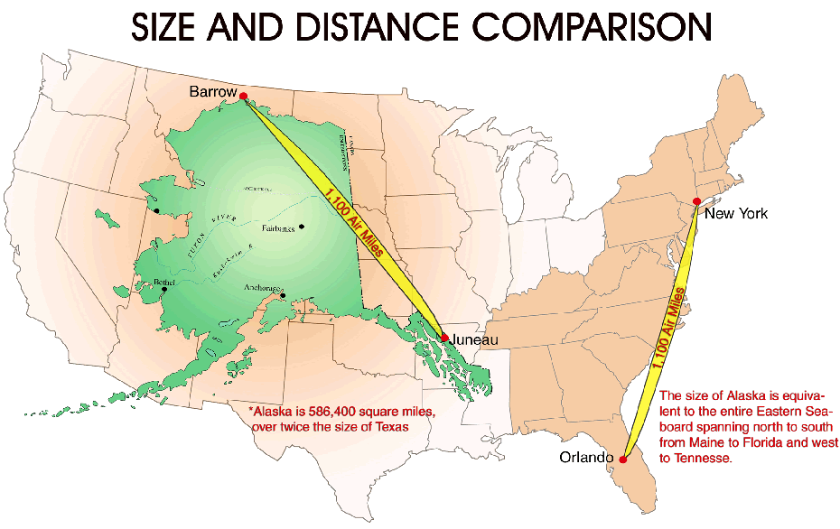
ALASKA

Slide 10
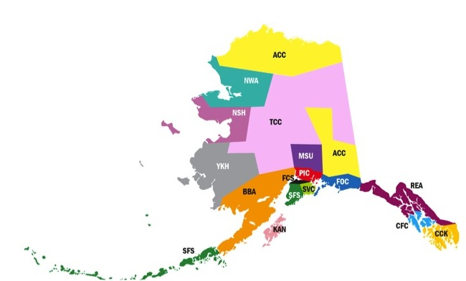
EI/ILP
Providers
EI/ILP
Providers

Slide 11
Yukon Kuskokwim region
Notes:
Bethel is a hub community- on left, Nightmute on the right.

Slide 12
Taking First Steps
Reviewed time, effort and cost data
Proposed purchase of online ASQ with Enterprise subscription for each regional ILP/EI agency allowing option to add referral/partner agencies as “programs”
Launched statewide ASQ Online initiative
Brookes representatives attended meetings in Alaska
ASQ Online introduced to ILP/EI agencies
Notes:
What our time, effort and cost data showed us was that according to the grant proposals, we were spending a lot of time and effort screening children. Over % of EI/ILP staff statewide are Master’s prepared or % of licensure/certiication? Screening by an OT is certainly less expensive than evaluating, but still very expensive relatively. The idea here was to support child find effort possibilities where children showed with regularity: doctors offices, child care programs, head start, home visiting programs. Etc. Win- win. Decreased expense for Part C increased access for children, resource allocation for staff.

Slide 13
Learning to Walk
Building partnerships
Early Childhood Comprehensive Systems
Early Periodic Screening Diagnosis Treatment (EPSDT) work group recommended the use of the ASQ
Head Start
Parents as Teachers
Alaska Pediatric Partnership

Slide 14
Finding our Stride
Limited Pilot with EI/ILP
Contract to provide ongoing support
Secured funds to engage (implement) statewide effort
ILP Grant agreement requires providing access to ASQ for primary referral sources

Slide 15
Overcoming Roadblocks
Initial Roadblocks
Confusion about purpose
Getting “buy-in”
Current Roadblocks
Concern about relationships
ASQ Online as one part of Child Find effort

Slide 16
Enjoying the View
Data
State level
Enterprise and program level
Ability to document Child Find effort

Slide 17
Implementation
Defining the Path
Taking First Steps
Learning to Walk
Finding our Stride
Overcoming Roadblocks
Enjoying the View
How Alaska is implementing a statewide system
Notes:
Establishing a statewide ASQ Online system

Slide 18
Defining the Path: Alaska’s Vision
State of AK, Part C - Hub
PIC
REACH
Sprout
FOCUS
MSCA
BBAHC
Frontier
SeaView
ACCA
YKHC
KANA
NW Arctic
TCC
CFC
NSHC
CC
Notes:
Establish the State of Alaska Part C Office as the “Hub”
Establish the 16 Early Intervention grantees as “Enterprise” accounts
Early Intervention grantees add “Programs” such as medical providers and early care and learning programs

Slide 19
Defining the Path:
Learning the Language
Of ASQ Online
Hub (State of AK-Part C)
Sprout
Kachemak Kids
OCS
KANA
KANA ILP
Hub
Enterprise
Program

Slide 20
first steps
ILP Agencies establish Enterprise Accounts
Agency approval
Hub linking agreement
Learning the ASQ Online system
Tutorials
Brookes training
Practice- time on system
Monthly Teleconferences
Notes:
Asked for ILPs to volunteer to participate in first cohort
Some were reluctant due to limited staff and too many projects. We had to learn the language of ASQ Online, figure out a plan of approach
Takes some time to learn the ASQ Online system
Resistance to change

Slide 21
Learning to walk: Family access
Adding Family Access to each Enterprise
Allows families to complete screening online
Increases access to screening
Also can be completed with health or early care provider
Eliminates duplication of data entry

Slide 22
Data Entry Method — Manual vs. Family Access
2012 — 13% of entries Family Access
2013 — 28% of entries Family Access
2014* — 43% of entries Family Access
*Jan. 1-Sept.30, 2014
Learning to Walk: Family Access

Slide 23
Hub – State Part C
Enterprise - PIC
Programs
Programs for Infants and Children (PIC)
Alaska Center for Pediatrics
Kids Corps Head Start/Early Head Start
Providence Hospital Child Development Program
Parents as Teachers
Finding Our Stride: Adding Programs
Notes:
Example: Programs for Infants and Children (Enterprise) in Anchorage invites programs to join their ASQ Enterprise system. ACP and Providence are examples of their individual outreach and HS/EHS and PAT are examples of statewide outreach

Slide 24
Comparison of program types — 2013 and 2014

Slide 25
Screen Usage by Type: Comparison Over Time

Slide 26
Overcoming roadblocks
Duplicate Data Entry
Security / Confidentiality Issues
Technology Insecurities
Staffing and Resources
Readiness

Slide 27
Enjoying the view
Shared Screening Effort
Increased Role for Parents
Increased Number of Children Screened
Increased Ability to Track Data
Strengthened Partnerships

Slide 28
Sprout Family Services:
enterprise Implementation
Defining the Path
Taking First Steps
Learning to Walk
Finding our Stride
Overcoming Roadblocks
Enjoying the View

Slide 29
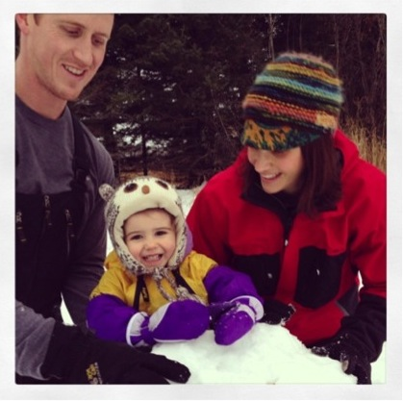
Sprout Family Services: enterprise Implementation
Notes:
Sprout services include the Infant Learning Program, Parents as Teachers Program, Imagination Library, Parenting Classes, Playgroups, and Lending Library.
Our mission is to Promote the Healthy Development of Children and Families.
Sprout has a working goal of encountering every single child in the region in some way, screening included.
We were first approached to provide ASQ Online through the Infant Learning Program. Sprout was already doing Child Development Screenings throughout the region, so we were excited to have a new tool to perhaps make our jobs easier, but really with the hope of being able to serve more children.

Slide 30
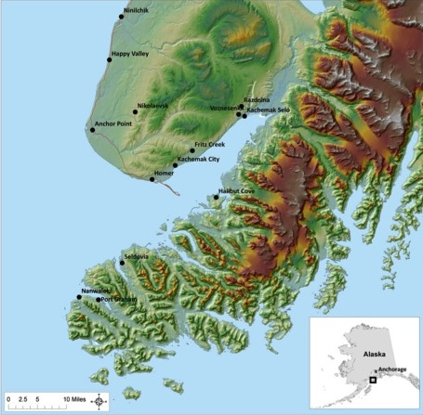
Southern Kenai Peninsula, Alaska
Notes:
Sprout Family Services is located on the Southern Kenai Peninsula.
The target communities comprise an estimated 12,000-14,000 residents with appx. 800 children under the age of five.
The service area encompasses the south end of the Kenai Peninsula with the hub community of Homer and 10 surrounding communities including those at the head of the bay and across the bay.

Slide 31
SPROUT’S PAST CHILD FIND EFFORTS
VISIT 10 INDIVIDUAL COMMUNITIES ONCE A YEAR
Cost
Day rate of staff + 2 hours prep for travel: $4,000
Travel (plane tickets or gas reimbursement): $1,214
Loss of staff client services? (not calculated)
Total cost of 10 days: $5,214
Outcomes of past efforts
52 ASQ/SE complete, leading to 12 referrals to Infant Learning Services
Notes:
Our past efforts were costly, inefficient and did not yield the results that we wanted. FY12
Cost per child: $100
Cost per referred Child: $435
% of children screened in region: .06%
We didn’t have good results, staff were spending their time screening instead of serving children.
If Sprout is hoping to interact with %100 of all children in the region to promote healthy development, we are a long way from our target.

Slide 32
Taking First Steps: What did it take to Get “Ready”?
Step 1: Set up intra-agency account
Step 2: Assign staff to manage
Step 3: Train all staff in ASQ database & provide on-going support
Step 4: Repeat steps 1 - 3 !
Notes:
After looking at the numbers, it was obvious to me that we wanted to take a broader approach to screening.
Inter-agency account took a while to set up.
Needed to have a point person. I tried to do it for a while, we had direct service staff doing it and then finally assigned it to an administrative part-time staff as one of her main duties. She was able to get the system up and running, get links working, and enter in our agency kids from paper files.
Trained staff in how to enter in their own paper files. Took a couple of staff meetings with admin staff support in training. Boiled down to a new expectation that staff will enter in their own screenings.
We continually have new staff trained and periodic trainings for staff to keep up with any changes.
Over all, main staff spends 10 hours per month. Direct service staff probably spend 5-10 minutes per child. Saves time with generating screening results, triggering new screenings, generating data.

Slide 33
Learning to Walk: Family Access
http://www.sproutalaska.org/
Notes:
One of the cool features of the Online ASQ system is that we as providers can continue to complete screens with families and enter them into the database for data collection and results, or we can choose to use Family Access.
Family Access is a link to the ASQ Online for families to complete the screens of their children under our agencies umbrella. This means that if a family does the screening, with electronic consent, we can see the results and monitor or intervene if necessary.
This is a screen shot of our agencies website, where families can click on the ASQ Online buttons and take the surveys themselves.
This really saves staff a lot of time and data input. This tool is normed for parents, so its very cool to empower families to do it themselves!
Marketing ideas:
iPads in partner waiting rooms with access to screening tool, QR Codes in marketing to link families, community fairs

Slide 34
Family access welcome letter

Slide 35
Family access: how it works

Slide 36
Finding our stride
Enterprise
Sprout
Kachemak Kids Early Learning Center
Office of Children's Services
Child Protection
Homer Medical Clinic
Part C Office-Hub
PIC
REACH
Sprout
FOCUS
MAT-SU
BBAHC
Frontier
SeaView
ACCA
YKHC
KANA
NW Arctic
TCC
Sitka
NSHC
Ketchikan
Step 1: Reach out to Partners
Step 2: Train Partners
Step 3: Continued T/TA and Support
Step 4: Repeat Steps 1—3!
Notes:
After we got our internal screening set up, Sprout was ready to add partners. Our goal is to have diverse partners in our region so that there is limited possibility that a child would be missed. So far we have partnered with our Parents as Teachers Home Visiting Program, Child Protective Services, 3 Medical Clinics and a Child Care Center.
Our staff created a general training session for interested partners. We have provided technical assistance with our CPS office through offering to enter in their screens until they have capacity to do it themselves. At a medical clinic, we have helped their clinic director create new procedures to imbed screenings into all well-baby exams.
Each partner has a completely different reason for joining our program and different needs for training.

Slide 37
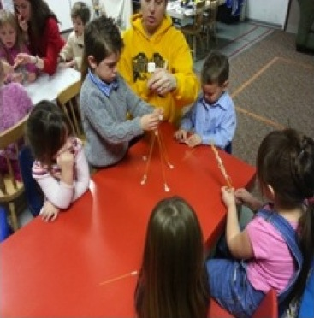
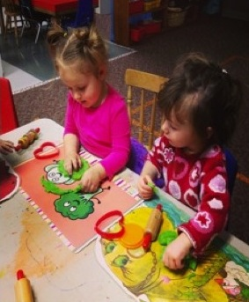
Child Care Partnership
Notes:
Concerned with kids – thought they may be experiencing delay, but not sure. Through observation, staff recognized that there were additional needs, not being met.
What happened?- Talked to Sprout- signed up as partner program, but no training in implementation in ASQ. Talked to Sprout and asked for Technical Assistance in providing screens. KK/Sprout co-created an individualized plan to teach KKELC staff how to provide the screenings and simultaneously how to enter them into the database. An admin staff was able to help us create online access… after screenings we were able to enter in results.
Contacted parents to seek signed consent for all students. We did it as a blanket for all students, all parents agreed to screen. The only ones that said no, had been screened through another program for ASQ. We were able to get access to their screening results and permission to move their electronic screening file to KK account, so that teachers have access to results.
Overcoming Road Blocks – Capacity, scheduling time. There was never the perfect time or opportunity, but we set it as a priority and developed two “KK Screening Days.” Explain plan to re-screen every 6 months and options for parents who want to participate more often. Personalized ASQ results.
Concerns based off their screening – sent out results to families with referral contacts. The screenings came back at age level, one was monitor and we sent out recommendations to do at home, any kids screening that came back with concern we asked parents to make referrals to Sprout ILP or School District for evaluations. One family chose to follow through.
How it fits into the normal activities of the day/week? Teachers are able to imbed strategies that are child centered in specific developmental domains. (Social groups/ Speech emphasis.)
Benefits- Teachers feedback? All staff were very positive about it. They loved being able to watch Sprout staff perform the ASQ’s to learn how to do it. Extra supports online, etc.
Teachers are now aware of students who may be struggling that they were not aware of. Now knowing which area each child is successful in, needing to be monitored or needing additional assistance, teachers can create lessons, activities, and projects geared towards each child’s needs and strengths. The ASQ’s allows us to become aware and address potential obstacles the child may face early on and provide families with suggestions to assist the child at home, such as games.
Parent Feedback? So far no negative feedback. Grateful that we did it. Several parents stated it had been on their o do list but they had never gotten around to it. Expectation to parents and any new families that bi-annual screenings are part of program culture. Parents who's children are needing further assistance have been grateful for to know now and are actively working with their children at home and getting further assistance if needed.
How will it be imbedded/ Next steps?- Will perform ASQ screenings every six months within our program and offer the option to parents to do it more regularly if they would like. Through the database we have been able to connect parents to the process and become more involved. The database also allows an automatic reminder for us, sending out the parent questionnaire and reminder that the ASQ’s are coming up. Although it is difficult to use one or two days for ASQ’s, we see the benefits of the program and utilize the results to better address the needs of each child as an individual.

Slide 38
Overcoming roadblocks
Parents
Staff
Partners
Notes:
Parents – Internet access – no app for phone yet,
-- Teach parents to incorporate child development screening into the general health of their child, empower community to have environmental shift to look at development, technology shift
Staff – Training (one more thing to do!) paradigm shift of control to partners/parents – Presenting ASQ – LET GO AND LET PARENTS OWN their child’s health
-- now can spend more time with intervention and less time screening out ineligible children
Partners – Hard for their capacity, taken a lot of technical assistance support
-- Developed stronger partnerships, seen as a resource, know appropriate referral
_________

Slide 39
Child Find FY2014
Year round
296 ASQ/SE’s completed
29 referrals

Slide 40
Enjoying the view
Parents — More parents are screening their children
Staff — Increased time spent with referral sources and with children with identified concerns
Partners - Child Find is an on-going community-wide effort
Notes:
What Child Find looked like this year so far:
Providers spent time teaching parents/partners how to screen their children
Data looks promising for more children screened – not just a once per year effort.
Child Find efforts will be spent in technical assistance for partner programs & continued environmental shift of screening for all children on Southern Kenai Peninsula

Slide 41
Thank you!
Feel free to contact us with questions!

